Slide 1
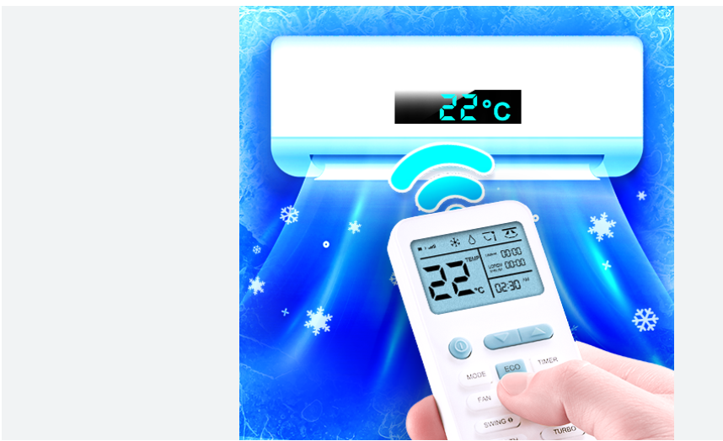
Smart AC Remote
"Traditional AC remotes have limitations. Smart appliances are on the rise. This remote offers convenience and customization. Get data insights into your cooling habits. The smart AC remote market is projected to grow significantly by 2028."
21BCS6325 – Nikhil Sharma
21BCS6301 – Pravesh Sharma

Slide 2
Smart System vs Existing AC Remote
Existing Systems
Proposed Smart System
Limited customization
Personalized profiles
Manual operation
Automated maintenance
Lacks real-time data
Real-time monitoring
High energy consumption
Guided preferences
Voice assistant integration

Slide 3
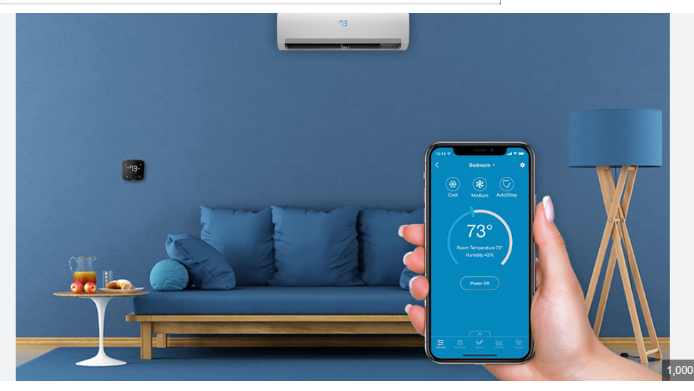
User Interface Design and Categories
,Remote Enthusiasts
Seeking precise control and customization. Ages 25-45, tech-savvy.
Busy Professionals
Prioritizing convenience and speed. Ages 30-55, appreciates automation.
Tech-Savvy Homeowners
Integrating into a smart home. Ages 35-60, early adopters.
Elderly Users
Simple interface. Ages 65+, simplicity is key.

Slide 4
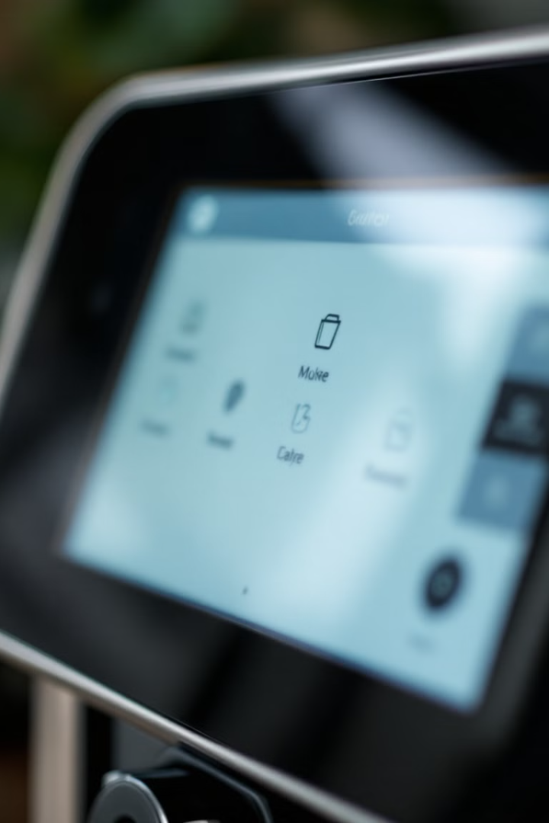
Heuristic Evaluation for Screen Design
1
Visibility of System Status
Clear indicators for brewing, whipped cream preference and grind size.
2
User Control and Freedom
Easily undo actions and exit unwanted states.
3
Error Prevention
Clear messages and prevents common mistakes.
4
Minimalist Design
Focusing on essential information.

Slide 5
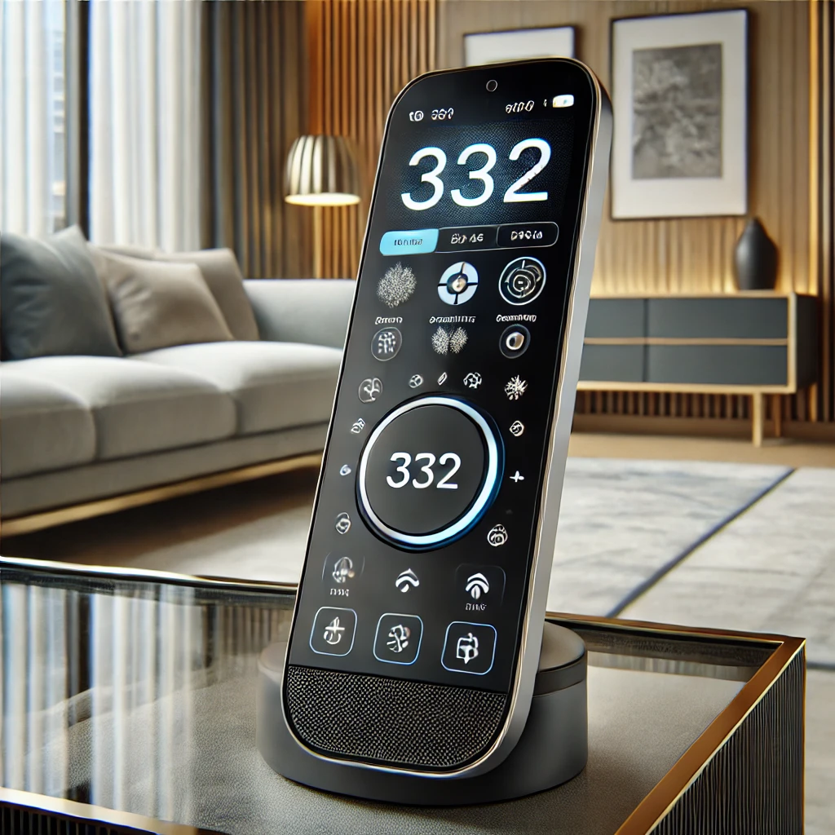



Inclusivity and Accessibility
Vision Impairment: High contrast, large fonts, voice control.
Motor Impairment: Large buttons, voice control, remote app.
Cognitive Impairment: Simplified interface, clear language.

Slide 6
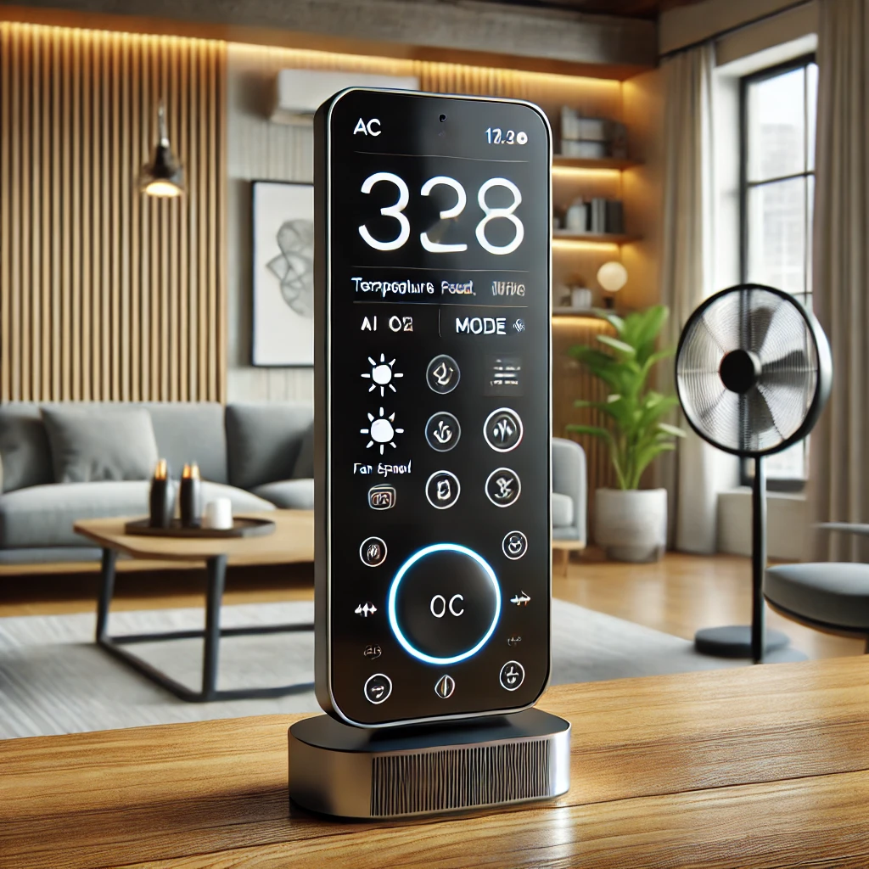




Smart Features and Functionality
Customizable Profiles
Adjust grind size, whipped cream preference and default cup.
Automated Schedules
Set custom brewing schedules for any day.
Remote Control
Start brewing from anywhere, monitor status.
Voice Control
Control using voice commands.

Slide 7
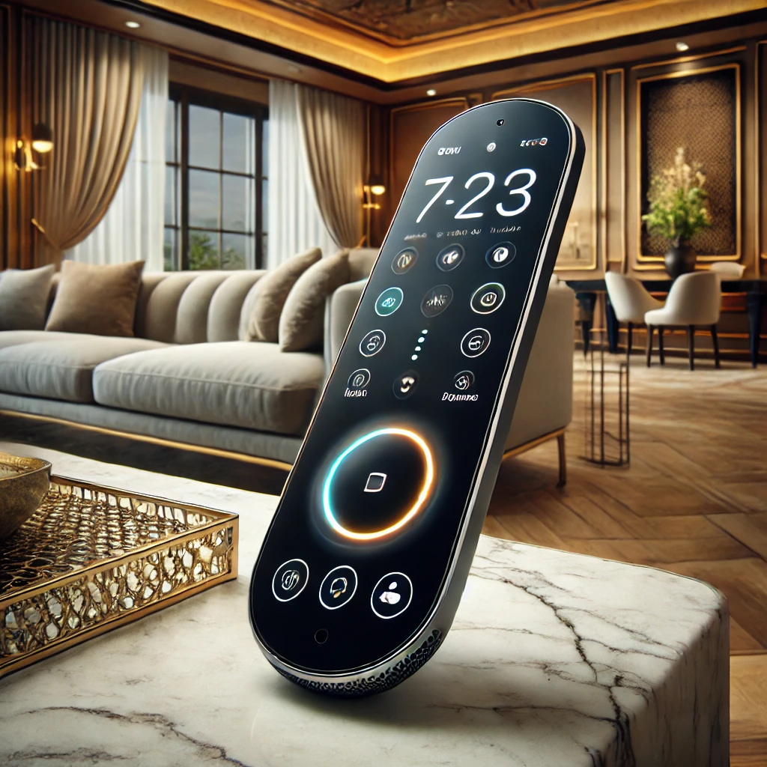
Conclusion: The Future of Coffee
The Smart Coffee Machine offers convenience and data insights. Embrace the future of coffee. Future: integration with smart home devices. Thank you.

